Slide 1
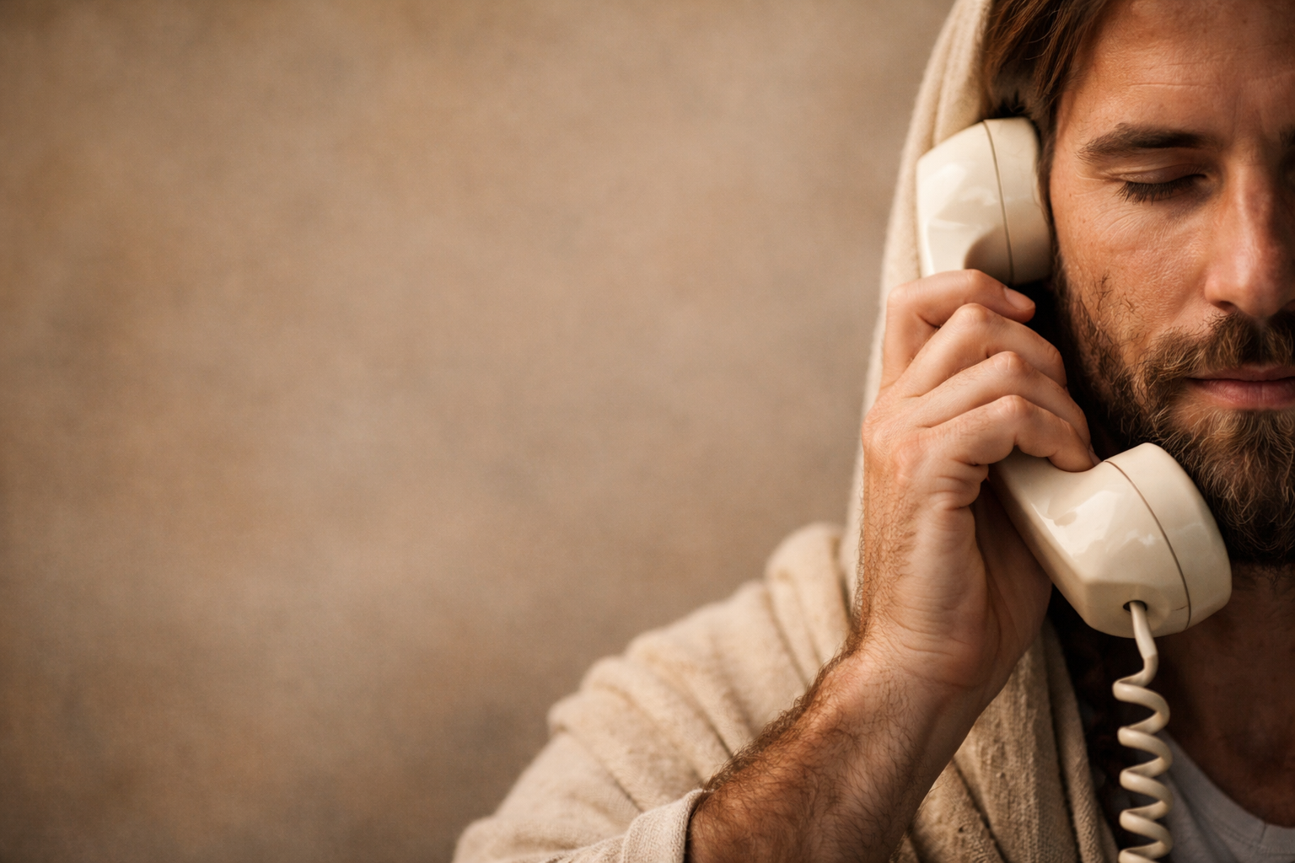
Does God Still Speak to People Like Us?
The Conversation
We’ve Been Waiting For

Slide 2
CONVERSATIONS
ARE HARD

Slide 3
WHY THIS MATTERS

Slide 4
RELIGION GIVES SCRIPTS

Slide 5
RELIGION GIVES SCRIPTS
JESUS HAS CONVERSATIONS

Slide 6
NICODEMUS – JOHN 3

Slide 7
“Very truly I tell you, no one can see the kingdom of God unless they are born again.”
John 3:3 (NIV)

Slide 8
“No one can enter the kingdom of God unless they are born of water and the Spirit.”
John 3:5-6 (NIV)

Slide 9
THE WOMAN AT THE WELL JOHN 4

Slide 10
“Will you give me a drink?”
John 4:7 (NIV)

Slide 11
“Whoever drinks the water I give them will never thirst.”
John 4:14 (NIV)

Slide 12
BRINGING IT HOME

Slide 13
WHY THIS MATTERS FOR US – AND FOR THE CHURCH

Slide 14
Our message is not just information.
Our message is transformation.
And transformation always begins with an invitation.

Slide 15
On the front of the card answer:
  What conversation does God want to have with me?
  What conversation do I need to have with someone else?
  What conversation might our church need to have with our community?

Slide 16
On the back, write 1 to 3 simple actions you will take for better conversation.
Keep the card.
Commit to Conversation

Slide 17
Does God Still Speak to People Like Us?
The Conversation
We’ve Been Waiting For

