Slide 1
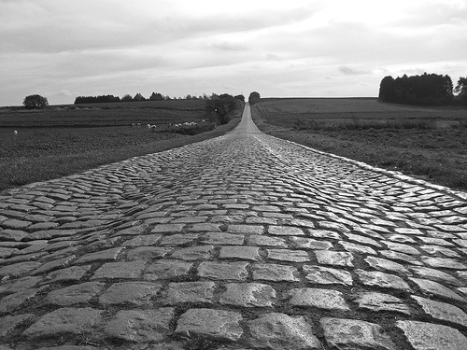
Walking With God
Part Ten— Walking With God Means Walking With Others III

Slide 2
The people of the early church were of one mind, one heart, one vision, and one voice. THEY WERE
UNIFIED.

Slide 3
Unity is the supreme need of the church.

Slide 4
In most of Paul’s teaching, what he comes back to is
unity.

Slide 5
We are unified in the spirit of God.

Slide 6
Unity does not mean uniformity.

