Slide 1
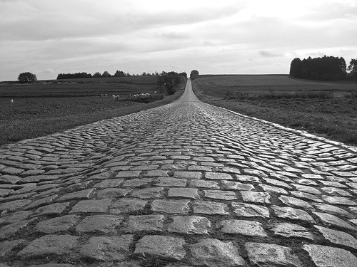
Walking With God
Part Nine— Walking With God Means Walking With Others

Slide 2
Professing faith in Christ is linked to considering one another.

Slide 3
To assemble means to hang out.

Slide 4
Verse 42 mentions two religious practices, receiving doctrine and prayer. And two non-religious activities, fellowship and breaking of bread.

Slide 5
The most complete expression of Christianity is not simply when we worship together and pray together; but when we hang out together as well.

Slide 6
To walk together we must have a heart of generosity.

Slide 7
The early believers were willing to sacrifice what was important to them to meet the need in a fellow believer’s life.

